Slide 1

Capstone Project-1
EDA Airbnb Bookings Analysis Team Members Anjali Tidke Shubham Dukare

Slide 2
Content :
1) Introduction.
2) General overview of dataset.
3) Missing value Handling.
4) Attribute inormation
5) EDA Analysis.
6) Conclusion.

Slide 3
Introduction:
Airbnb, Inc. is an American company that operates an online marketplace for lodging, primarily homestays for vacation rentals, and tourism activities. Based in San Francisco, California, the platform is accessible via website and mobile app.
Since 2008, guests and hosts have used Airbnb to expand on traveling possibilities and present a more unique, personalized way of experiencing the world. Today, Airbnb became one of a kind service that is used and recognized by the whole world. Data analysis on millions of listings provided through Airbnb is a crucial factor for the company.
These millions of listings generate a lot of data - data that can be analyzed and used for security, business decisions, understanding of customers' and providers' (hosts) behavior and performance on the platform, guiding marketing initiatives, implementation of innovative additional services and much more.
This dataset has around 49,000 observations in it with 16 columns and it is a mix between categorical and numeric values.

Slide 4
General overview of dataset.
This dataset has around is mix between categorical and numeric values.
Price is a dependent column.
Total 16 columns are present in the dataset.
Total observations are 48895.
Min of Price variable is 0, max is 10000$.
Mean price is 152$
On an average people stay 7 days in a room.
75 Percentage of times minimun nights stayed is 5.
Mean reviews given to Room/apart ment is 23.

Slide 5
Missing value Handling.
‘name’ = 16 null values.
‘host_name’ = 21.
‘last_review’ = 10052.
‘reviews_per_month’ = 10052
‘name’ column we will replaced the ‘nan’ values with corresponding ‘room_type’ values.
‘host_name’ will not use as those are names of individuals.
'reviews_per_month' we will replace with 0 for NA values.
In ‘last_review’ We will convert its data type to catogorical and replace 'NA' with 'never'.

Slide 6
Attribute Information:
id : Unique listing id.
name : Name of the property
Host_id : unique id for each listed host
Host_name : Name of the host.
Neighbourhood group : A neighbourhood or neighborhood is a geographically localised community within a larger city, town, suburb or rural area,
Neighbourhood : the area or region around or near some place or thing
Latitude : Latitude coordinates
Longitude : Longitude coordinates
Room type : Listing space types
Number_of_reviews
Last review

Slide 7
Attribute Information:
12. Reviews_per_month Calculated_host_listings_count Availability_365
13. price : Price in dollars
14. minimum_nights : minimum nights required to stay
15. number_of_reviews : No. of reviews written for the listing
16.last_review : Last reviewed date for the listing
17. reviews_per_month : Total review per month for the listing
18. calculated_host_listings_count : Total no of listing against the host id
19. vailability_365 : Number of days when listing is available for booking.

Slide 8
Data inspection:
The dataset contain 48895 rows × 16 columns.
There are some missing values in some column's, this are counted as follows:
Name:16
Host _name: 21
Last review: 10052
Review per month:10052
We are removed last review and review per month columns because of large number of data is missing as well as removed latitude and longitude columns because this columns are not affected on analysis.

Slide 9
EDA:
Explored and analyzed the data by using multivariate analysis:
What can we learn about different hosts and areas?
What can we learn from predictions? ex: locations, prices, reviews, etc)
Which hosts are the busiest and why?
Is there any noticeable difference of traffic among different areas and what could be the reason for it?

Slide 10
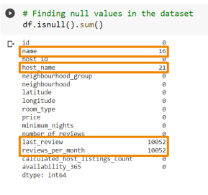
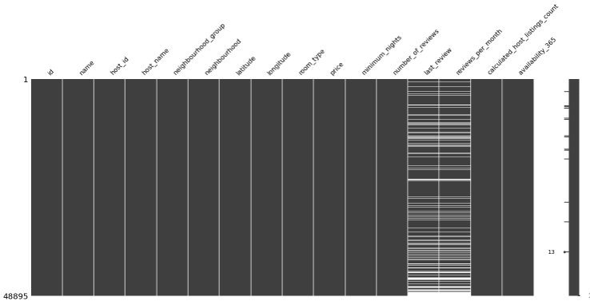
Null values in the dataset
• Last_reviews – 10052 null values
• reviews_per_month - 10052 null values
• host_name – 21 null values
• name – 16 null values

Slide 11
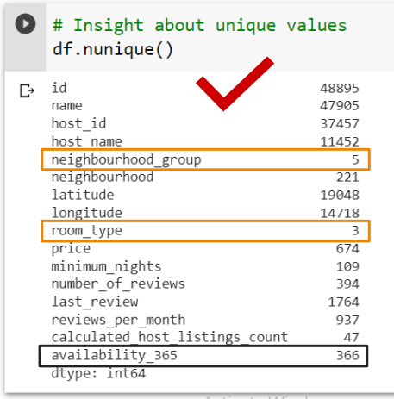
Have a look on unique values:

Slide 12
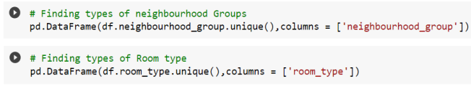
Neighbourhood_ groups & Room_types

Slide 13
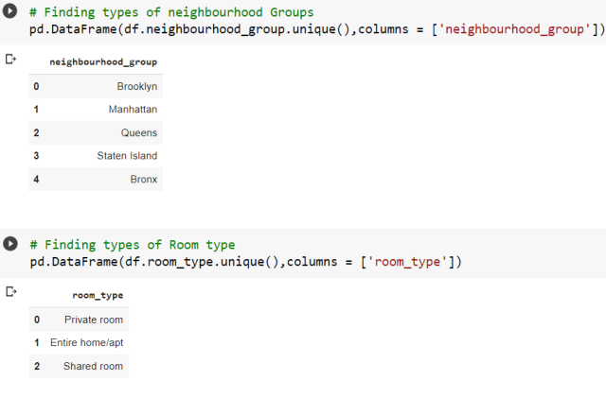
Neighbourhood_ groups & Room_types

Slide 14
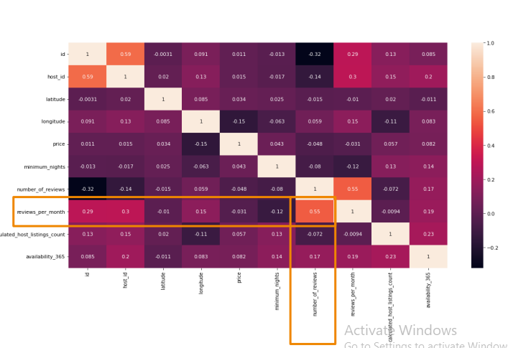
Is our data have any relations?
Heat map showing Relations between the columns

Slide 15
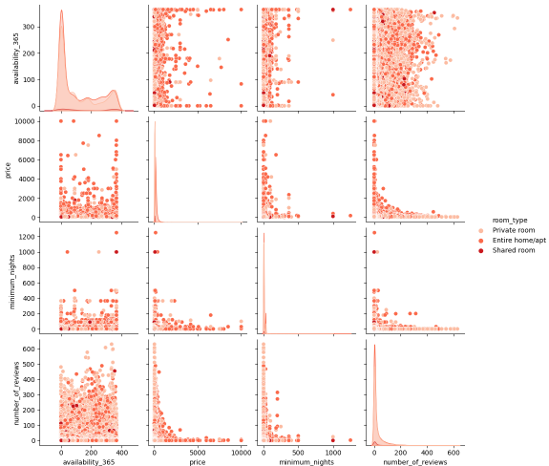
Pairplot of –
• Availability_365
• Price
• Minimum nights
• Number of reviews

Slide 16
Pairplot of –
• Availability_365
• Price
• Minimum nights
• Number of reviews Results –
• Unexpected minimum nights at 0 availability

Slide 17
Pairplot of –
• Availability_365
• Price • Minimum nights
• Number of reviews Results –
• Unexpected minimum nights at 0 availability
• As minimum nights of booking increase price decreases significantly.

Slide 18
Pairplot of –
• Availability_365
• Price
• Minimum nights
• Number of reviews Results –
• Unexpected minimum nights at 0 availability
• As minimum nights of booking increase price decreases significantly.
• There are more number of reviews where price is low

Slide 19
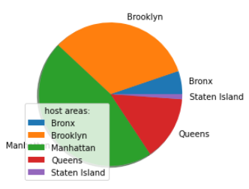
EDA (Exploratory Data Analysis)
1.0 What can we learn about different hosts and areas?
Result:
1. Manhatten & Brooklyn are having high no. of listing.
2. Staten island and Bronx have low no. of listing.
Inference:
If we want to do advertisement or marketing for selling flats we should focus on Manhattan and Brooklyn.

Slide 20
EDA (Exploratory Data Analysis)
2.0 What can we learn from predictions? (ex: locations, prices, reviews, etc)
2.1 Area Vs Number of Review
2.2 Price Vs Number of Review

Slide 21
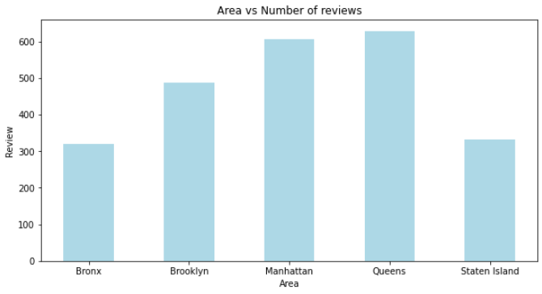
2.1 Area Vs Number of Review
Inference:
1. From this analysis we got to know that Manhatten,Queens have highest no of review and this are profit making business for the host as they are highest no.of review
2. Having property in staten island and bronx is a loss making business for the host as they are empty half of year.

Slide 22
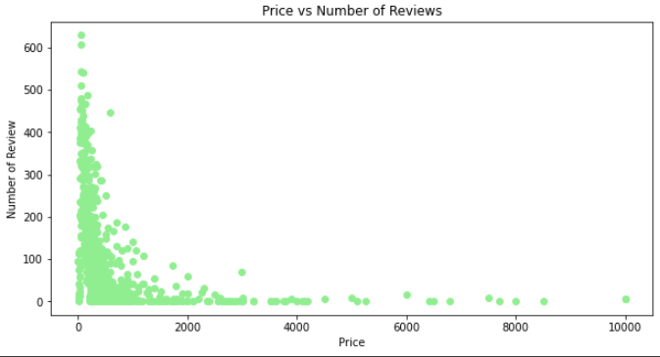
2.2 Price Vs Number of Review
From the this Analysis we can say that most people prefer to stay in place where price is less.

Slide 23
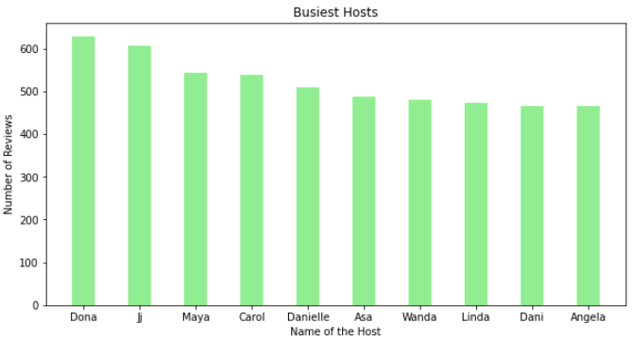
EDA (Exploratory Data Analysis)
3.0 Which hosts are the busiest and why?
From this analysis the most busiest host is Dona & Ji has large no.of reviews listing than other host.

Slide 24
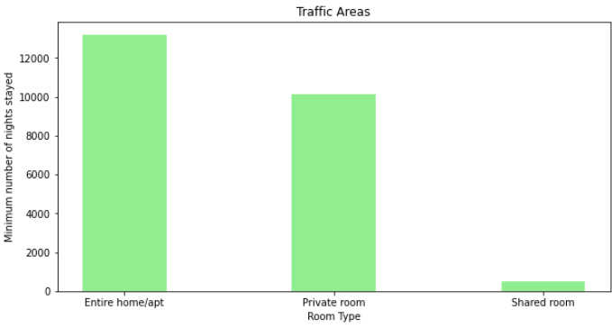
EDA (Exploratory Data Analysis)
4.0 Checking Is there any noticeable difference of traffic among different areas
Inference: As we can see, in every neighbourhood “Entire home” has generated the most revenue. So buying a property "Entire home" and renting it, is a profitable business irrespective of neighbourhood type

Slide 25
Conclusion
Entire home/apt is highly expensive.
Manhattan living cost is highest, Bronx living cost is lowest.
Cheapest neighbourhood is Bulls head.
The Cheapest listing is the Bronx apart.
Manhattan have the highest no. of listing.
In Manhattan entire home is mostly preferred but in Brooklyn ratio between the entire home and private room is 50:50.
Private room has the highest availability; the Entire home has least availability.
Revenue generated by Entire home is highest irrespective of neighbourhood group.
Sonder have a maximum property in New York.

Slide 26
THANK YOU!

